Slide 1
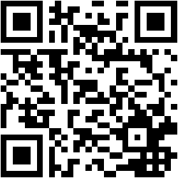
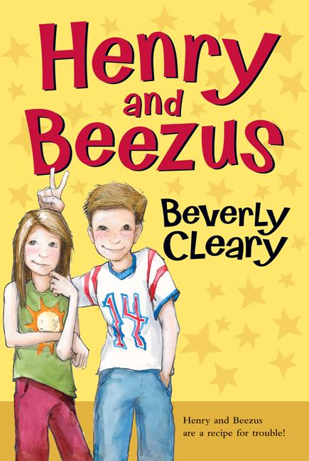
Henry And Beezus
By Beverly Cleary
Other books by Beverly Cleary
Ramona and Her Father
Ribsy
Dear Mr. Henshaw
Ralph S. Mouse
Runaway Ralph

Slide 2
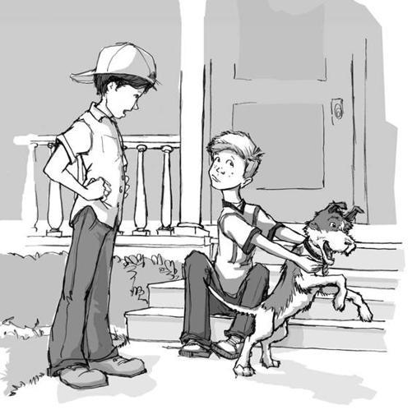
Genre
The genre is realistic fiction because it can happen in real life but the story is made up by the author.

Slide 3
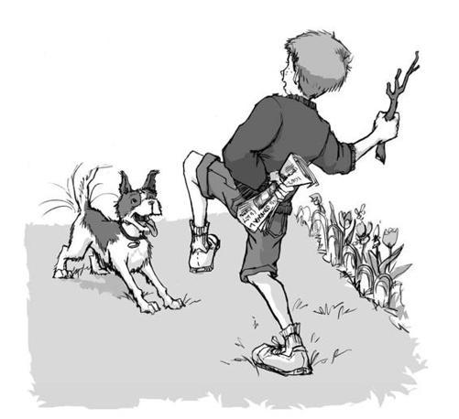
Setting
The story takes place in many places. It starts out at Henry’s house where he is asking for a bike because he sees Scooter showing off on his street, Klickitat Street. The next chapter of the book starts off in a field where Henry finds boxes of gum. After that, the story moves to Henry’s school. Henry and his friends go to the Police Station for a auction to win a bike. The book ends at the Rose City Bike and Trike Shop.

Slide 4
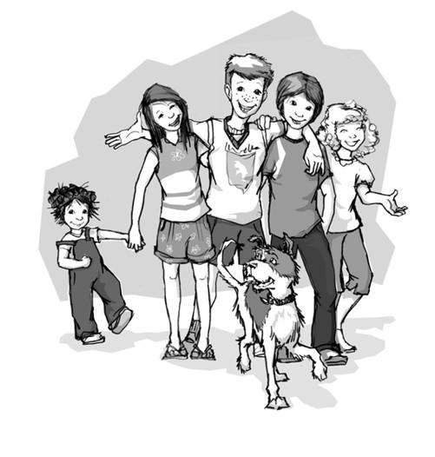
Summary
This book is about a boy name Henry. He really wants a bike. His parents can not afford a bike so Henry is trying to find ways to earn money to buy the bike. Henry’s best friends are Robert and Beezus. They try to help him all through the book. Some of the other main characters in the book are Ramona (Beezus’ little sister), Scooter (a boy that lives on his street) and Henry’s dog Ribsy.
Henry finds boxes of gum in a bush in a field and decides to sell the gum to his classmates. This gets him into a lot of trouble. His next idea for earning money for the bike, is to help Scooter with his newspaper route while he is at Scout Camp. But before that could happen, Henry found out about an auction for bikes at the police station. He was able to get a bike but it was a girl’s bike and it was all bent and did not work well.
There was a new Colossal Market opening. He and his parents went to the grand opening and there were door prizes. Henry won a door prize. It was for coupons for the salon for haircuts, perms and false eye lashes. Everyone was laughing because this was a prize for a girl, not a boy. The kids were daring Henry to eat the dog food samples and Henry thought if he did this, they would stop making fun of the prize he won. Henry eat the dog food, but everyone was still making fun of him for the prize and now for eating dog food.
Beezus asked Henry if she could buy one of the coupons from Henry for $1.05. After this, Scooter’s mother bought one, Henry’s mother bought one and soon, he had sold all the coupons. Henry had gotten $50 for all his coupon. He still needed $9.95 so he could buy the red bike he saw at Rose City Bike and Trike store. Henry’s dad said he would give him $10. Henry finally got the red bike he had always wanted.

Slide 5
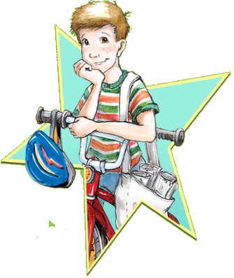
Recommendation
I Recommend Henry And Beezus because I liked the story. I liked this story because the story was really interesting.It was interesting because it had a lot of different things that could happen in real life. I think that both boys and girls would like this story because it has both a boy, Henry, and a girl, Beezus, as the main characters.

