Slide 1
The Get Rich Quick Club
By: Dan Gutman

Slide 2
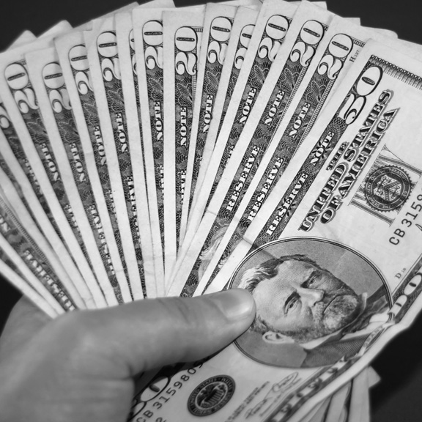
Genre
The genre of The Get Rich Quick Club is fiction because the characters are not real and the events did not happened.
For example, kids selling pictures of UFO’s to earn $10 million dollars has not happened.

Slide 3
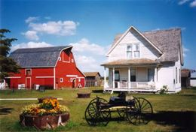
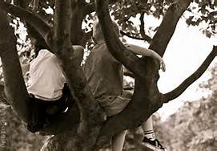
Setting
The Get Rich Quick Club setting takes place in Farmington where the kids are in a tree talking about their plan to get rich.

Slide 4
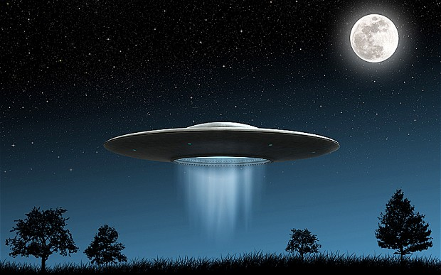
summary
The Get Rich Quick Club - by Dan Gutman
There are 5 main characters named Gina Tumolo who is eleven years old and loves money and wants nothing more than to make a million dollars this summer. Her best friend is Rob, Quincy, and her other two friends the Bogle twins, Eddie and Teddy who are eight years old. The kids are on summer vacation and they are really bored. They decide to create a business plan where they take a fake photo of a garbage can and make it look like a UFO. First they tried to sell it to The National Truth but they turned them down then they tried to sell it to Farmington Journal. The Farmington Journal gave the kids $15 million dollars to buy the UFO picture. However, when Gina went on TV she froze and couldn’t speak. Then Teddy and Eddie started talking and made even more lies. In the end everybody found out they lied .Then they actually see one and they tell Farmington but they didn’t believe Gina, Eddie, Teddy, Rob and Quincy.

Slide 5
Evaluation
I really enjoyed this book because it is full of excitement, laughter and comedy. I recommend that Ms. McElwee’s class reads Get Rich Quick Club by Dan Gutman because they will find a lot of surprises in the story.

