Slide 1

My Life in Pink and Green by Lisa Greenwald
Report By: Riley Ferguson

Slide 2

Genre
My Life in Pink and Green is all about Realistic Fiction. I know this because Lucy’s family problem could totally happen. Also, it has dialogue that people would actually say. Pharmacies close down all the time today because of big-time stores like Wal-Mart. In addition, you could open a business on your own, help out around the world, and love to do research even if that does sound a little unrealistic.

Slide 3
Setting
The settings in My Life in Pink and Green are really important. Lucy gets inspired to save her family business, the Old Mill Pharmacy, while she is working there. The Old Mill High School is where Lucy and her best friend Sunny start Earth Club and find the Going Green Grant (GGG). Lucy’s room was very important. It’s the place where Lucy sent in the GGG or Going Green Grant that saved everything! The next door movie theater is also a big part of the setting because people going to the movies would often go to Lucy’s family pharmacy to buy inexpensive snacks. The movie theater helped keep the Old Mill Pharmacy in business.

Slide 4
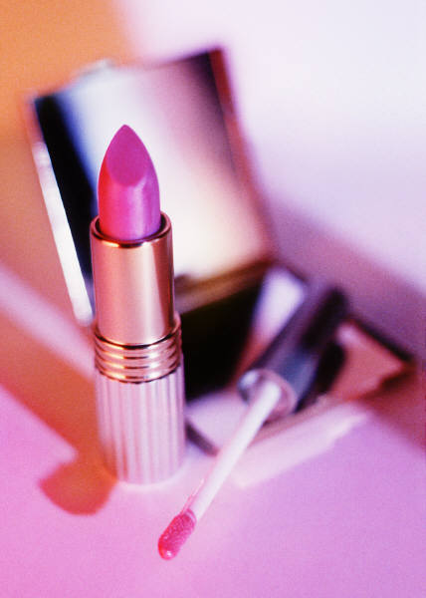
Summary
Lucy Desburg's family's pharmacy is going to close. It’s the place Lucy grew up in and she doesn't want to lose it. Lucy has always been amazing at doing hair and makeup, and all that comes in handy when the local homecoming queen walks in. She had a hair emergency and needed help! Soon, word got out that Lucy saved her look in time for the big dance. Profits went through the roof when tons of teens came to the pharmacy for advice and makeup! They made a lot of money, but not quite enough to stay in business. So when Lucy found The Going Green Grant she was amazed! Will Lucy win the grant? Will she save the pharmacy? Find out when you read My Life in Pink and Green by Lisa Greenwald!

Slide 5
Recommendation
I was fascinated by My Life in Pink and Green. I though it was amazing because just one girl saved a whole business and helped the world while she was doing it! Also it was phenomenal that she was such an artist when it came to makeup! I love books that are realistic, a bit romantic, and have a heart-stopping cliff hanger in each chapter. If you are a fashion lover, I think you would like this book too! At the beginning of each chapter Lisa Greenwald threw in a little tip for life. If you like cliff hangers, romance, and realistic fiction you will love My Life in Pink and Green!
I loved this book! It deserves five stars for sure!

Slide 6
Thanks for watching!!!

