Slide 1
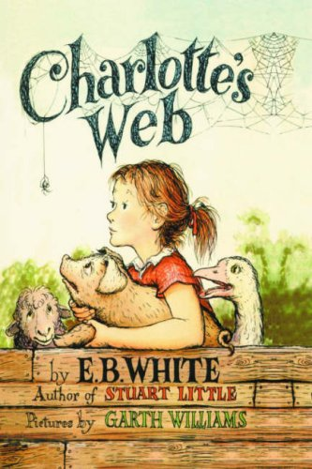
Charlotte`s Web
This book certainly won`t leave you hanging, but it will make you blood thirsty for more!
By E.B. White

Slide 2
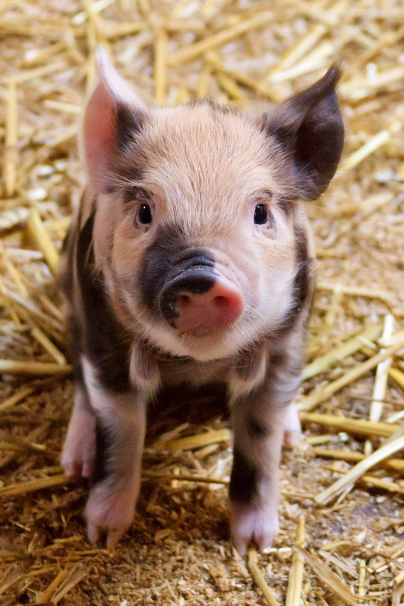
Genre
The genre for this book is realistic fiction. I know this is realistic fiction because all of the characters, settings, and events could happen in real life. Those things are realistic. The things that are fiction is that animals and insects can`t talk. I know all of this because when I read the book, I comprehended to myself and I figured out that the story was realistic fiction. That is the genre of my book, Charlotte`s Web.

Slide 3
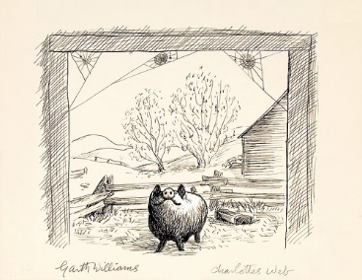
Setting
In this story Charlotte`s Web, there are three settings. The settings are in Fern`s house, at her uncle`s barn and the county fair. Fern`s uncle`s farm is the main setting. That is where a lot of things happened. That barn is where Wilbur became famous with the help of Charlotte, the spider. Fern`s house is where fern`s brother Avery gets into a lot of trouble and where Wilbur was almost killed, but Fern saved him. Lastly, the county fair is where Wilbur won a special award and where Charlotte died. Each of these places have a meaning and a story. Also, each of these places have a lot of memories too. Some were good and some were bad. All that matters is that each place has a special place in all of the character`s hearts.

Slide 4
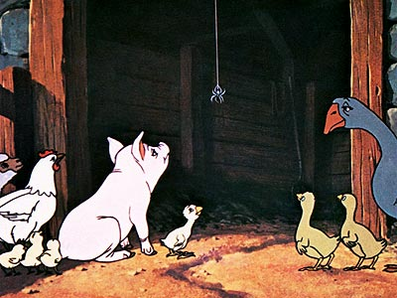
Summary
Jacqueline McGarry Charlotte`s Web
This story Charlotte`s web is about a spider named Charlotte who does amazing things for a pig named Wilbur. It all started out when Fern`s dad, one of the characters, tried to kill a pig named Wilbur. Then Fern saves him. So then Wilbur starts to take care of him as he were her own son. Then, Fern has to go to school after her summer break. Wilbur was very upset.
A few days after Fern went back to school, Fern`s dad sells Wilbur to Fern`s uncle, Mr. Zuckerman. Fern is very upset. Wilbur doesn`t know a single animal. It is very hard for Wilbur right now. Then he starts to adjust.
One night he hears a voice. A small voice tells him to go to sleep, and he will see who ever spoke in the morning. In the morning he saw a spider. Wilbur was very confused. When Wilbur got to actually got to know each other, they became good friends. Mr. Zuckerman was actually talking about killing Wilbur.
Charlotte had to come up with an idea to make Mr. Zuckerman to change his mind. So, she came up with an idea. She wrote the words SOME PIG on her web the next morning. When she did that, she actually made Wilbur famous. People from around the country wanted to see the web and Wilbur. This was going to change their lives, and it did.
There was actually the county fair that was coming up. The family entered Wilbur into the county far contest, best pig. When they got to the county fair, they got Wilbur entered in the contest. He didn`t win, but he did win another award that they had. When Wilbur was up on stage he fainted of excitement. Charlotte wasn`t doing well. When Wilbur went home from the fair, Charlotte was dead. It was very tragic and sad. If you want to read about what happens next read the book. I am sure that it will touch your heart. Because it had touched mine.

Slide 5
Recommendation
I recommend this book, Charlotte`s Web because the book takes you on an exciting adventure about a pig named Wilbur and a spider named Charlotte who are the best of friends. When Charlotte writes the words SOME PIG on her web, that is when all of the exciting things happen. When Charlotte does that, it takes them to a whole new level. That level was a little challenging at first, but as they went along, they experienced some things they didn`t even know were possible. So, if you read this book, I am, sure it will take you on an amazing adventure just like Wilbur and Charlotte took.

